Slide 1
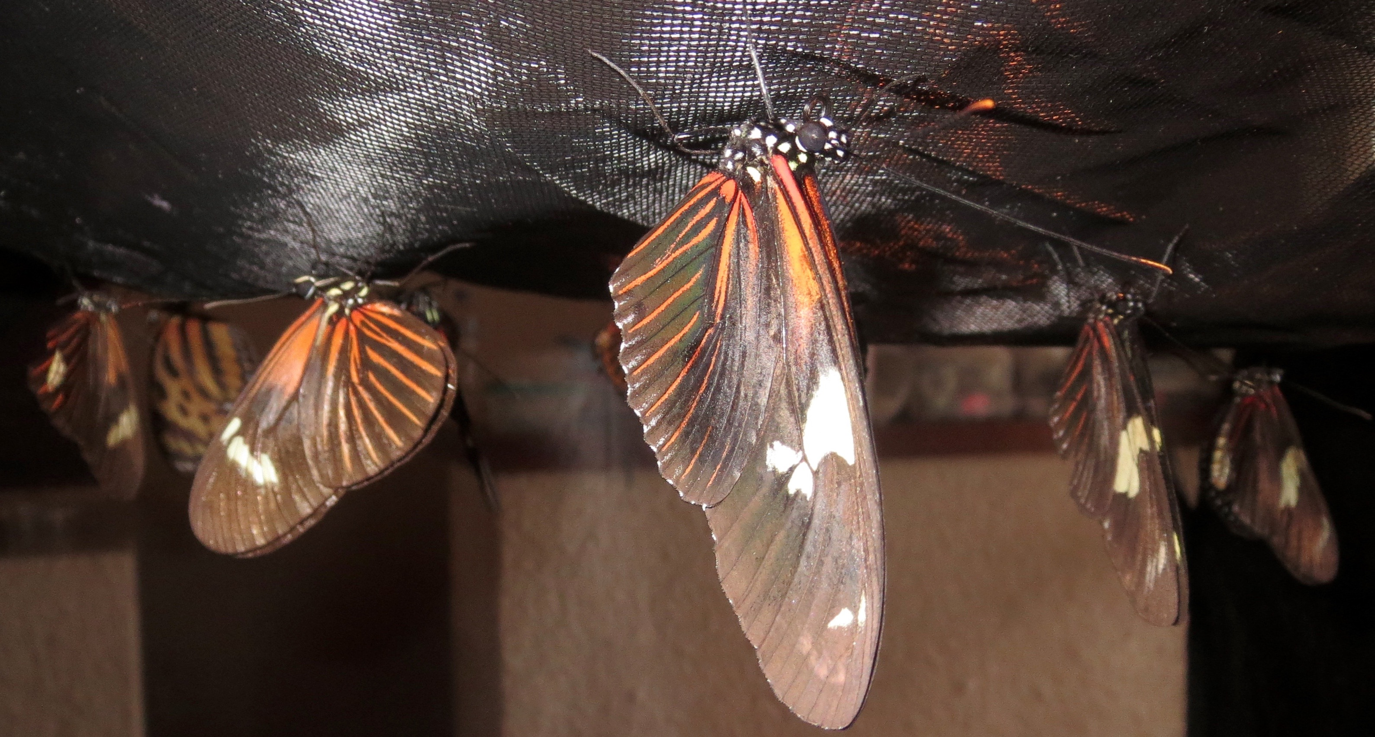

One, Two, Skip a Few: Insights into adaptive radiation through 20 Heliconiini genomes
Nate Edelman

Slide 2
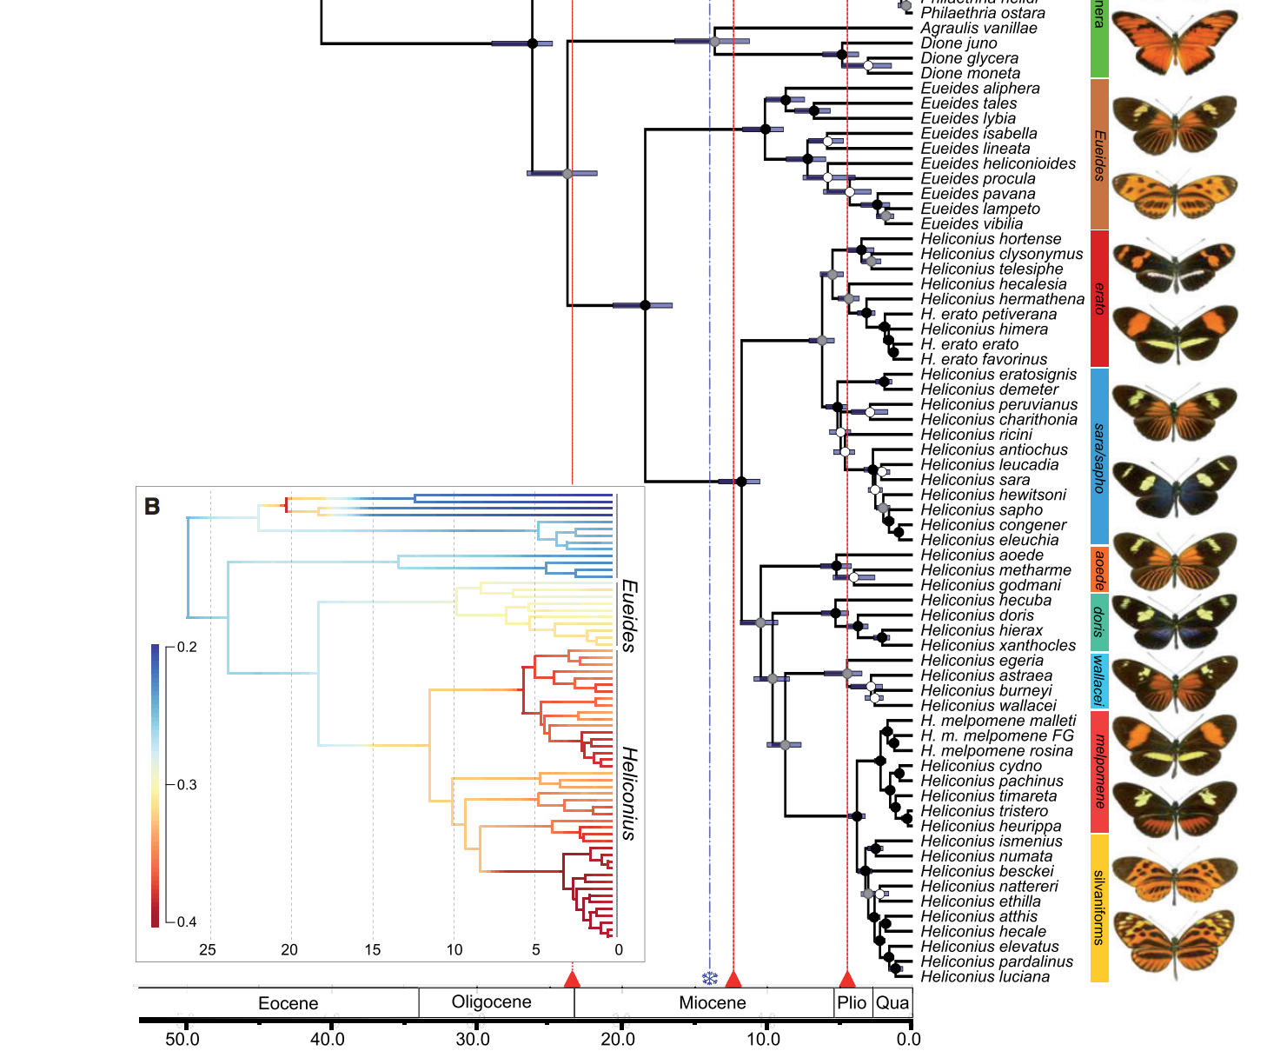
Heliconiini
Kozak et al 2015, Syst Biol
Notes:
Pervasive conflict between loci can be caused by introgression, but phylogenies based on gene trees cannot give metrics of this introgression, nor can they identify agents of divergence. For that, we need whole genome data.

Slide 3
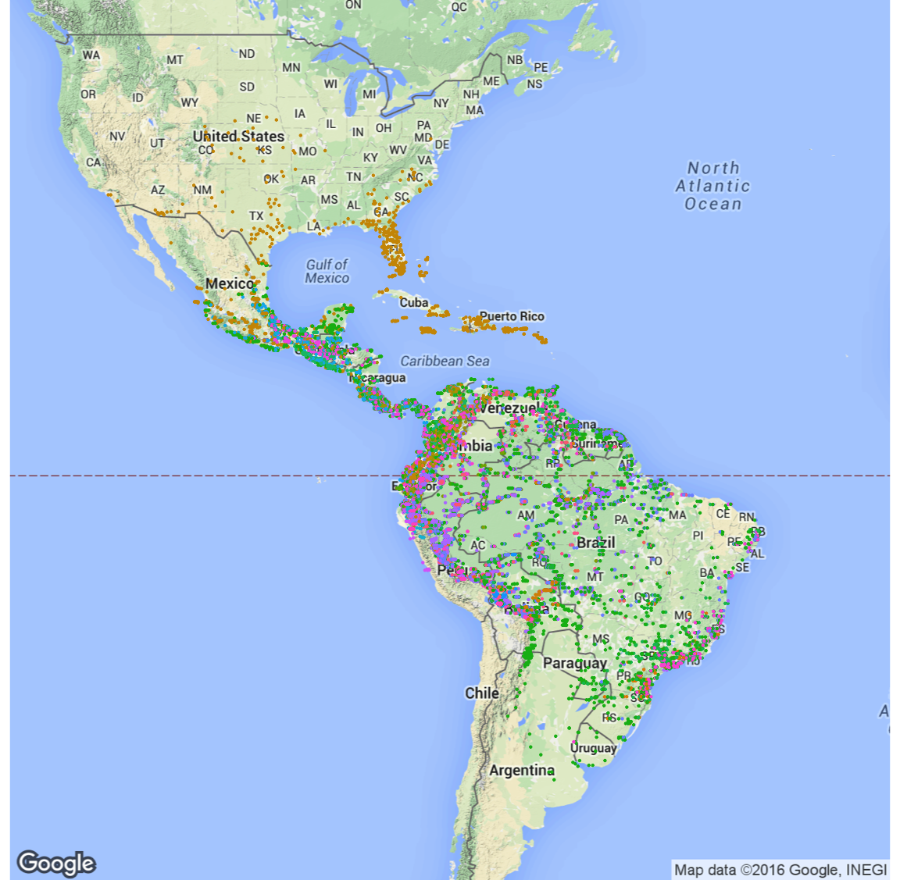
Data from Rosser, et al 2012, Biol J of Linn. Soc.

Slide 4
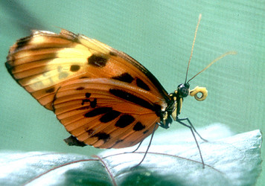
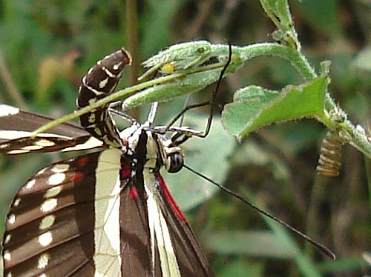
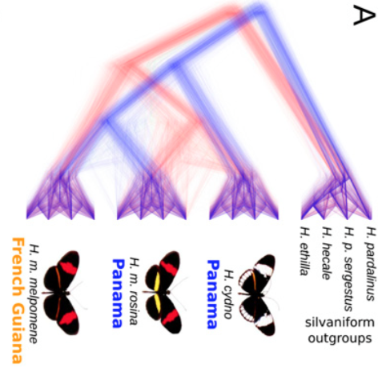
Dynamics of Adaptive Radiation
How have Heliconius been so successful?
How have Heliconius become so diverse?
heliconius.org
johnbokma.com
What role has hybridization and introgression played?
Martin et al 2013 Genome Res.

Slide 5
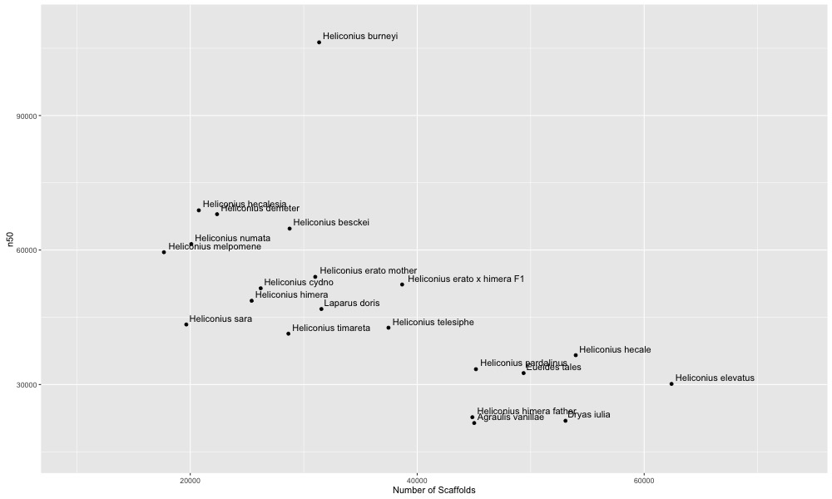
DISCOVAR assemblies
Paired-end, 250bp Illumina sequencing
60X coverage

Slide 6
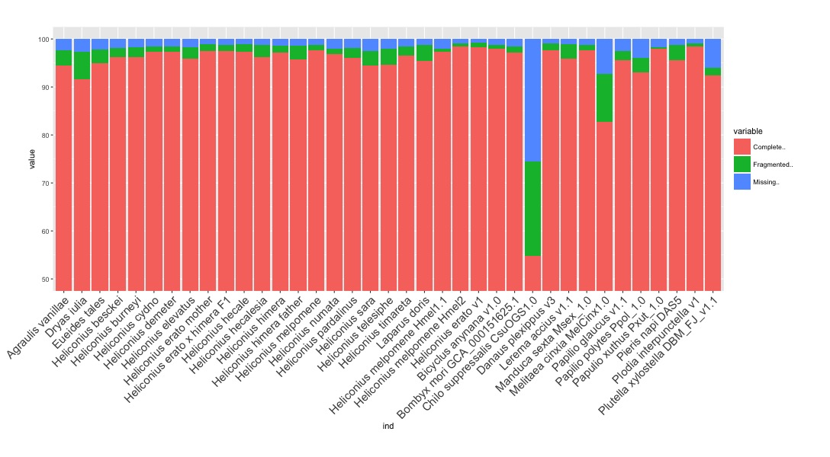
Gene Content BUSCO

Slide 7
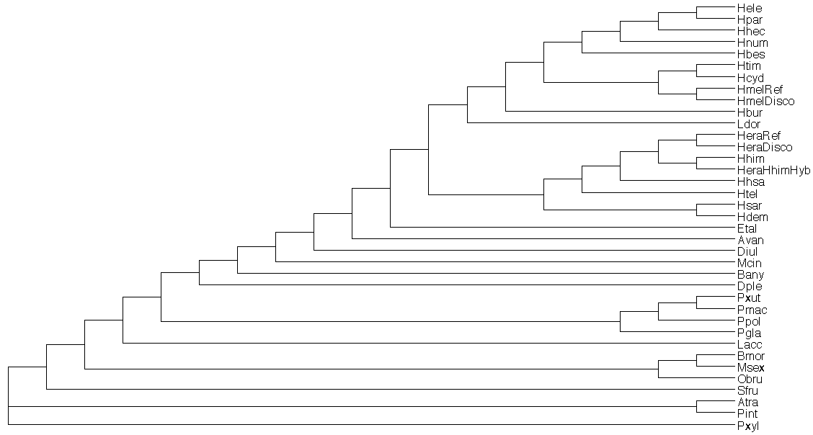
Multiple Genome Alignment
progressiveCactus: Alignment using cactus graphs
Improve performance around small-scale genomic rearrangements
Use phylogenetic information to generate alignments hierarchically
Output orthologous blocks of sequence across all individuals
Heliconiini
Nymphalidae
Butterflies
Moths

Slide 8
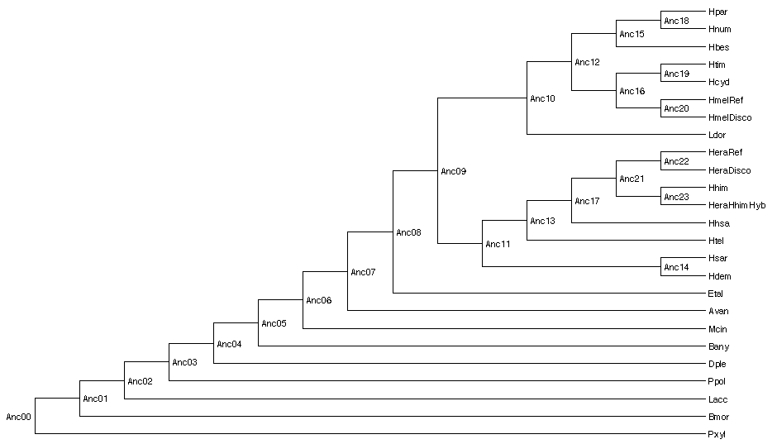
Multiple Genome Alignment
progressiveCactus: Alignment using cactus graphs
Improve performance around small-scale genomic rearrangements
Use phylogenetic information to generate alignments hierarchically
Output orthologous blocks of sequence across all individuals
Heliconiini
Nymphalidae
Butterflies

Slide 9
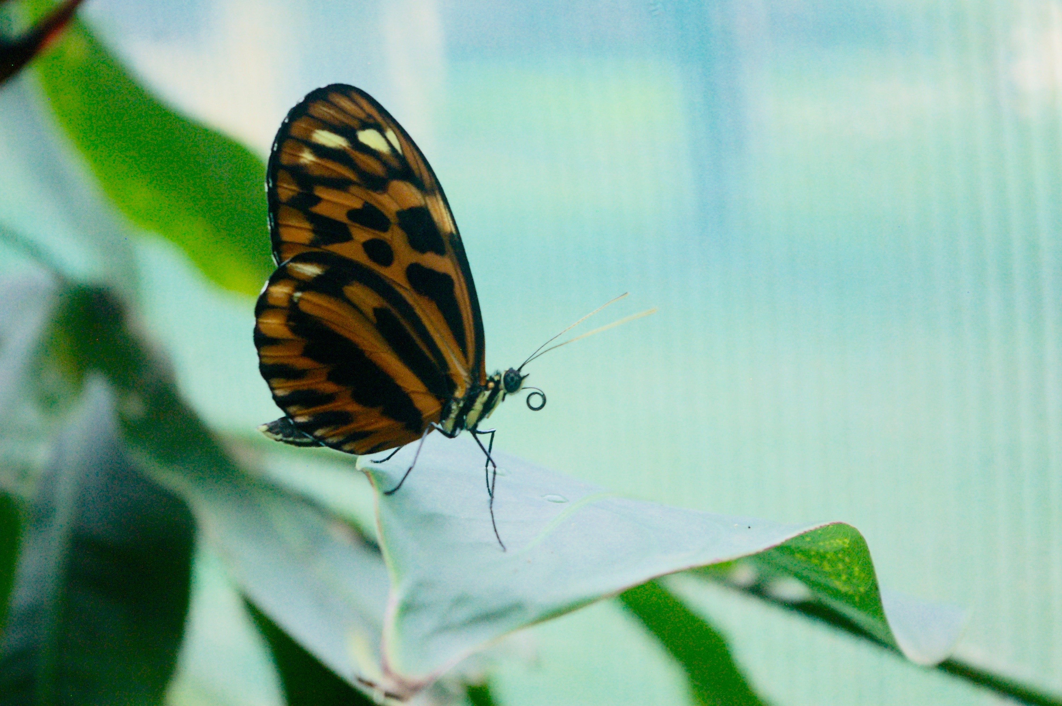

Thank You!
Mallet Lab
Smithsonian Institution
Dr. Jim Mallet
Dmitro Kryvokhyzha
Dr. Qiao Liang
Jarreth Caldwell
Christian Perez
Dr. Paul Frandsen
Dr. Rebecca Dikow
Cambridge University
Bioinformatics
Dr. John Davey
Dr. Michele Clamp
Dr. Adam Freedman
Dr. Tim Sackton
Dr. Aaron Kitzmiller
TGAC, Norwich
Dr. Federica di Palma
Dr. Bernardo Clavijo

